Slide 1
SIGNATURE RECOGNITION SYSTEM
Institute of Engineering and Management, Kolkata
3rd Year
CSE(IOTCSBT)

Slide 2
SWE PRESENTATION- 1
Team Leader – Rene Ghosh (37)

Slide 3
DEVELOPERS
Tusharika Mandal, 12021002017057
Rene Ghosh, 12021002017059
Aniket Paul, 12021002017066
Debanjan Bhattacharjee, 12021002017061

Slide 4
INTRODUCTION
A signature recognition system is a technology that aims to identify and verify individuals based on their handwritten signatures. Signatures have been used as a form of personal authentication and authorization for centuries, particularly in financial and legal contexts. Signature recognition systems utilize various techniques, often involving a combination of hardware and software, to analyze and authenticate signatures.

Slide 5
REQUIREMENT ANALYSIS
Technical and Non technical
Signature recognition involves the automated process of verifying and authenticating signatures for various applications, such as financial transactions, document validation, and identity verification.

Slide 6
REQUIREMENT ANALYSIS
TECHNICAL REQUIREMENTS:
Feature Extraction: The system should extract relevant features from the captured signature images, such as stroke trajectory, pen pressure, pen angle, and other distinctive attributes.
User Management: The system should have user management capabilities to store and associate signatures with user profiles. It should allow for the addition, deletion, and modification of user profiles and their corresponding signatures.

Slide 7
REQUIREMENT ANALYSIS
Signature Matching: The system should have a signature matching module that compares the extracted features of the input signature with the stored reference signatures. It should implement algorithms like Dynamic Time Warping (DTW), Hidden Markov Models (HMM), or Convolutional Neural Networks (CNN) to determine the similarity between signatures.
Thresholding and Decision Making: The system should have adjustable threshold parameters that determine whether a signature is considered genuine or forged based on the matching results. It should provide a decision-making mechanism to classify signatures as genuine, suspicious, or forged based on the calculated similarity scores.

Slide 8
REQUIREMENT ANALYSIS
NON TECHNICAL REQUIREMENTS:
Accuracy and Reliability: The system should have a high accuracy rate in distinguishing between genuine and forged signatures. It should be robust against various forms of signature forgery attempts, such as tracing, simulating, or replicating.
Maintenance and Support: The system should be maintainable, allowing for updates, bug fixes, and enhancements as needed. A support mechanism should be in place to address user inquiries and technical issues.
Scalability: The system should be scalable to accommodate a growing number of users and signatures without compromising performance. It should handle concurrent signature verification requests efficiently.

Slide 9
FEASIBILITY STUDY
A feasibility study for signature recognition involves assessing the viability and potential success of implementing a signature recognition system. This system can be used for various applications, such as biometric authentication, document verification, and fraud prevention.

Slide 10
TECHNICAL FEASIBILITY STUDY
Convolution Neural network: A Convolutional Neural Network (CNN) is a class of deep learning algorithms specifically designed for image analysis and recognition tasks. They are highly effective in capturing intricate patterns and features within images
Performance Metrics: Define the criteria for success and the performance metrics that will be used to assess the system's accuracy and reliability. Metrics could include False Acceptance Rate (FAR), False Rejection Rate (FRR), Equal Error Rate (EER), and Receiver Operating Characteristic (ROC) curves.
Data Privacy and Security: Address concerns related to data privacy and security, especially when dealing with biometric information like signatures. Ensure compliance with relevant regulations (e.g., GDPR) and implement encryption and secure storage practices.
Image Processing: Image processing is a field of computer science and engineering that involves manipulating digital images to enhance their quality, extract useful information, or transform them for various purposes.

Slide 11
LEGAL FEASIBILITY STUDY
Legal and Ethical Considerations: Address legal and ethical issues, such as consent for using signatures, ownership of the data, and potential biases in the recognition system
Risk Assessment: Identify potential risks and challenges that could impact the success of the project, such as technical limitations, data quality issues, or regulatory hurdles.

Slide 12
NOW THE QUESTION IS WHICH SDLC MODEL TO CHOOSE AND WHY?
The choice of an SDLC (Software Development Life Cycle) model for signature recognition depends on various factors such as project complexity, team size, and development requirements. However, iterative models like Agile or Spiral could be beneficial due to their flexibility and ability to accommodate changes during the development process, which is important in fine-tuning and improving signature recognition algorithms.

Slide 13
SDLC MODEL :- SPIRAL MODEL
The Spiral SDLC model is particularly suited for projects with high uncertainty or those that involve complex requirements. Signature recognition can be a challenging task that often requires iterative refinement and continuous improvement to achieve accuracy. The Spiral model allows for incremental development and incorporates feedback from users or stakeholders at each iteration.
Since signature recognition algorithms may need adjustments, improvements, and adaptations based on real-world usage and diverse signature samples, the Spiral model's iterative approach provides the flexibility to refine the system gradually and make necessary changes as the project progresses. This can lead to a more robust and accurate signature recognition solution over time.

Slide 14
LITERATURE REVIEW
In depth study of 3 research papers is done before proceeding with the project. Notable research papers are mentioned below.
Offline Handwritten Signature Verification And Recognition Based On Deep Transfer Learning Using Convolutional Neural Networks by Ataollah Askari Hemmat , Hossein Rabbani, Atefeh Foroozandeh :- proposed a method that uses a CNN based signature verification method to prevent the forgery. Their method consists of separately trained CNN architects for WI AND WD. They used the GPS synthetic Signature dataset which has been widely used in the signature verification field. In the first model, CNN was trained via WD signatures. One person's 54 signatures which includes 24 genuine and 30 forgeries were used. Randomly selected 30 signatures from the pool of signatures used for training. The signatures consisted of 15 genuine and 15 forgeries. Another 24 signatures were used for the test. The model is composed of five Conv2D layers, two MaxPooling2D layers, three Dense layers and two Dropout layers. In the model, every Conv2D layer is supported by a ZeroPadding2D layer. Used signature images are gray scale images sized as 300px width and 210px height.

Slide 15
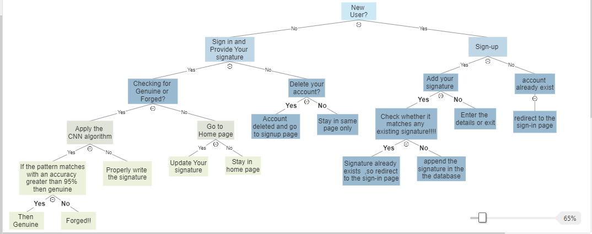
DECISION TREE
Presentation title

Slide 16
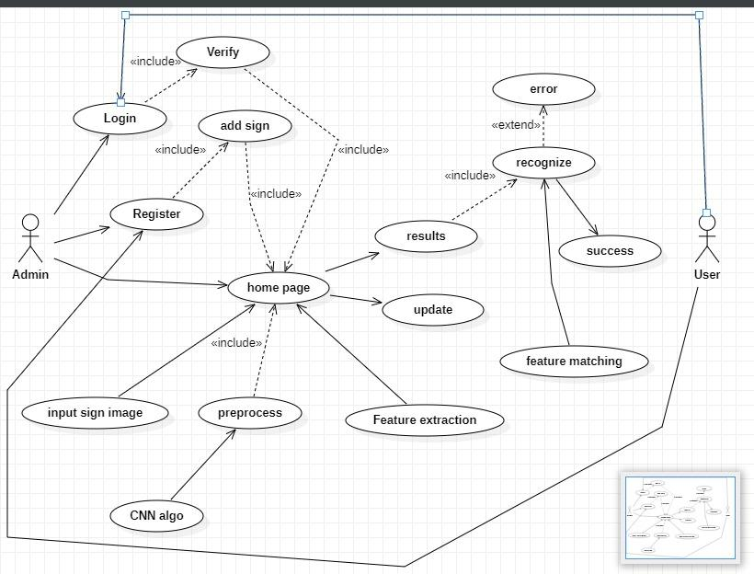
USE-CASE DIAGRAM

Slide 17
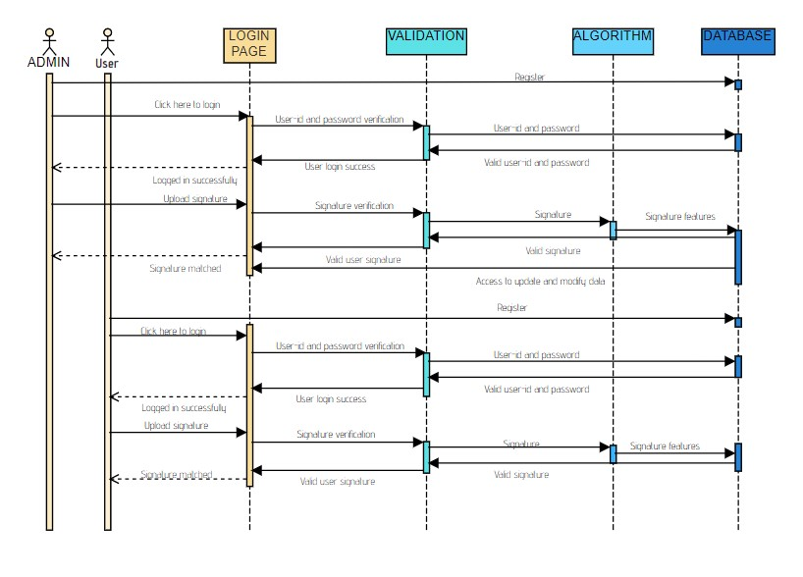
SEQUENTIAL DIAGRAM

Slide 18
DATA FLOW DIAGRAM
LEVEL 0
SIGNATURE RECOGNITION SYSTEM
0
VALID AND ACCESS TO UPLOAD ,MODIFY
VALIDITY
USER
ADMIN
USERNAME ,PASSWORD AND SIGNATURE
USERNAME ,PASSWORD AND SIGNATURE

Slide 19
LEVEL 1
UPLOAD IMAGE
0.2
SIGNATURE RECOGNITION
0.3
UPLOADED SIGNATURE
SIGNATURE
Login into the account
ERROR
VERIFICATION OF THE USERNAME AND PASSWORD
0.1
DISPLAY
0.4
VALID OR NOT VALID
USERNAME AND PASSWORD
RESULT
Username and password

Slide 20
LEVEL 2
FEATURE EXTRACTION
0.3.2
FEATURES OF THE SIGNATURE
FILTERED SIGNATURE
CHECK VALIDATION
0.3.3
IMAGE PROCESSING
0.3.1
RESULT(VALID OR NOT VALID)
SIGNATURE IMAGE

Slide 21
Level 3
Maxpool
0.3.2.2
Fulconnected + ReLu
0.3.2.3
GRAY SCALE IMAGE
0.3.1.2
Image
NOISE REMOVED IMAGE
IMAGE IN GREY FORM
Image
NOISE REMOVAL
0.3.1.1
Image
Softmax
0.3.2.4
NORMALISATION
0.3.1.3
Convolutional + ReLu
0.3.2.1
FILTERED IMAGE
SIGNATURE IMAGE
Image
Image

Slide 22
CONCLUSION
Signature verification systems aim to automatically discriminate if the biometric sample is indeed of a claimed individual. In other words, they are used to classify query signatures as genuine or forgeries. This requirement analysis provides an overview of the functional and non-functional requirements for a signature recognition system. These requirements will serve as the foundation for the system's design, development, and testing phases, ensuring the creation of a reliable and effective signature recognition solution.
Feasibility studies are intended to provide a comprehensive overview of the project's potential challenges and benefits. They help decision-makers make informed choices about whether to proceed with the project and how to address potential obstacles.

Slide 23
THANK YOU

